Slide 1
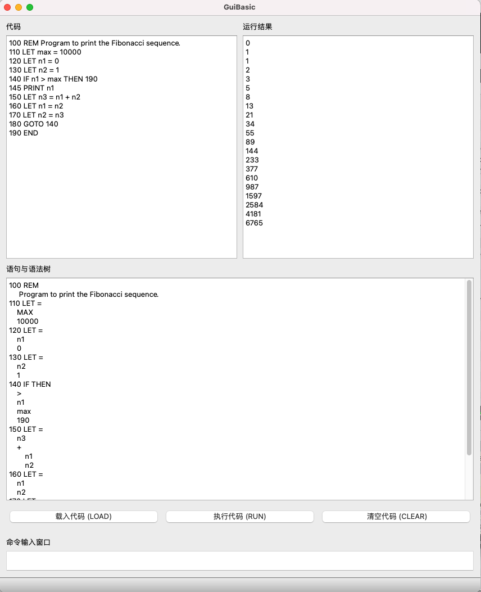
QBasic

Slide 2
QBasic
(10’) 你的解释器需要能够展示GUI，并且和用户交互
GUI需要能够展示输入和输出
(20’) 你的解释器需要能够载入和编辑basic程序
用户能够通过input box或者Load按钮来增加，更新，和删除程序语句
用户输入的语句能够被保存并且正确地显示出来
(50’) 你的解释器需要能够正确地执行（interpret）basic程序
Expression parsing (display the syntax tree, although this should be done when you store the programs);
Expression evaluation and statement execution (display the result of print if exists);
Runtime context maintenance (e.g., the current line to be executed, all variables and their values).
(10’) 你的解释器需要能够正确地处理（可能的）错误输入和操作
(10’) 代码质量、风格、注释等
答辩时间: 学期末（具体时间会根据学期末考试安排来定）

Slide 3
Expression Trees & Parsing & Evaluation
Most materials from Eric Roberts’s lectures

Slide 4
3 * (7 + 1) / 2 - 9

Slide 5
3
*
7
+
1
/
2
9
( )
-
3 * (7 + 1) / 2 - 9

Slide 6
+
3
*
7
1
/
2
9
( )
-
3 * (7 + 1) / 2 - 9

Slide 7
*
+
3
7
1
/
2
9
( )
-
3 * (7 + 1) / 2 - 9

Slide 8
/
*
+
3
7
1
2
9
( )
-
3 * (7 + 1) / 2 - 9

Slide 9
-
/
*
+
3
7
1
2
9
( )
3 * (7 + 1) / 2 - 9

Slide 10
-
/
9
*
2
3
+
7
1
3 * (7 + 1) / 2 - 9

Slide 11
-
Pre-order
/
9
*
2
3
+
7
1
3 * (7 + 1) / 2 - 9

Slide 12
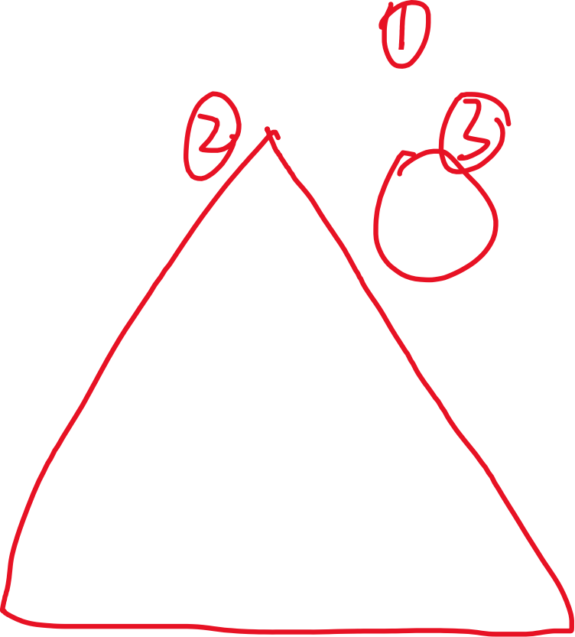



-
Pre-order
/
9
*
2
3
+
7
1
3 * (7 + 1) / 2 - 9

Slide 13
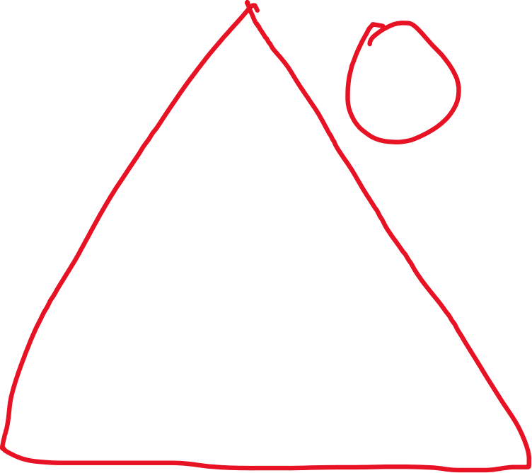





-
Pre-order
/
9
*
2
3
+
7
1
3 * (7 + 1) / 2 - 9

Slide 14
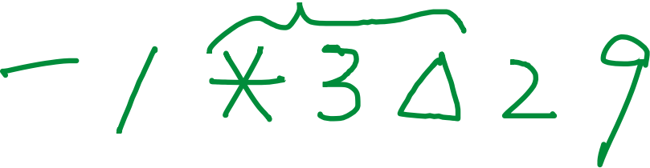
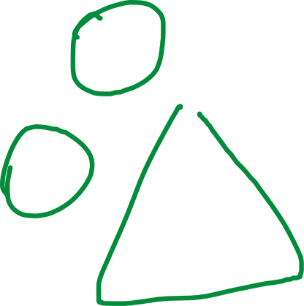
-
Pre-order
/
9
*
2
3
+
7
1
3 * (7 + 1) / 2 - 9

Slide 15
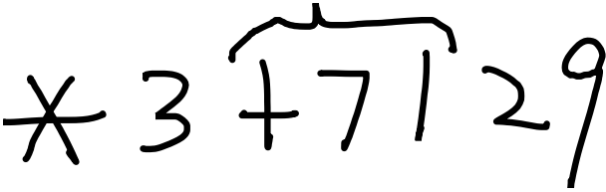

-
Pre-order
/
9
*
2
3
+
7
1
3 * (7 + 1) / 2 - 9

Slide 16
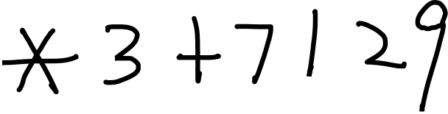
-
Pre-order
- / * 3 + 7 1 2 9
/
9
*
2
3
+
7
1
3 * (7 + 1) / 2 - 9

Slide 17

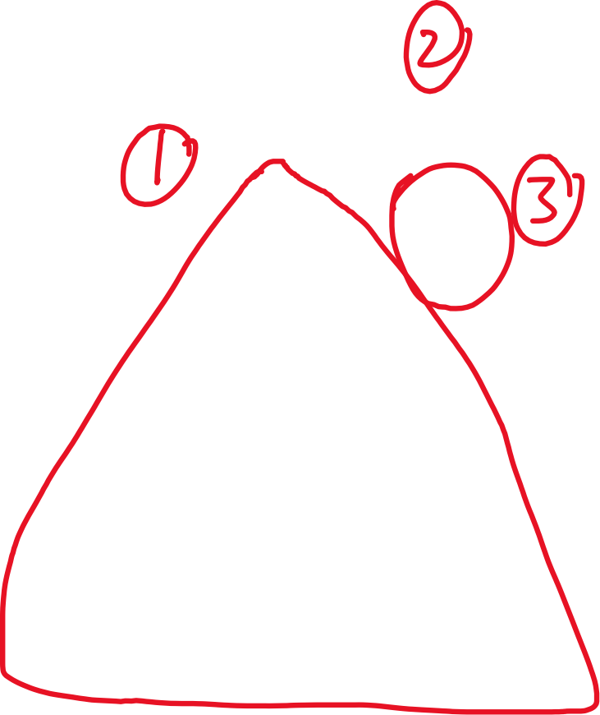


-
Pre-order
- / * 3 + 7 1 2 9
/
9
*
2
In-order
3
+
7
1
3 * (7 + 1) / 2 - 9

Slide 18

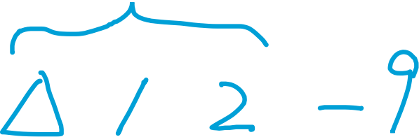

-
Pre-order
- / * 3 + 7 1 2 9
/
9
*
2
In-order
3
+
7
1
3 * (7 + 1) / 2 - 9

Slide 19
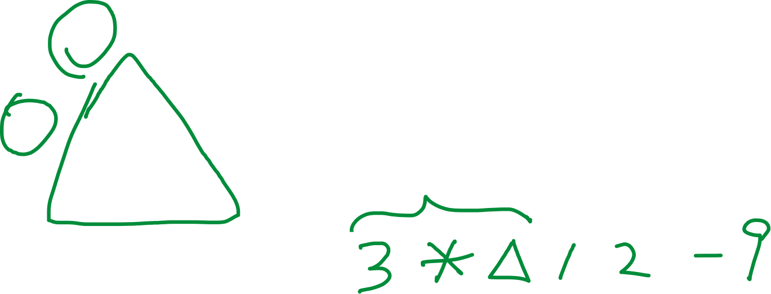
-
Pre-order
- / * 3 + 7 1 2 9
/
9
*
2
In-order
3
+
7
1
3 * (7 + 1) / 2 - 9

Slide 20
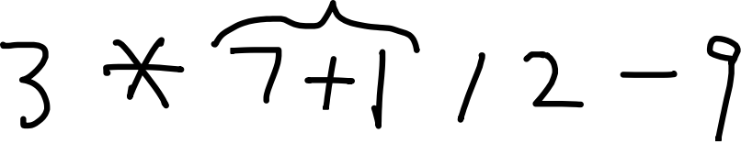
-
Pre-order
- / * 3 + 7 1 2 9
/
9
*
2
In-order
3
+
7
1
3 * (7 + 1) / 2 - 9

Slide 21
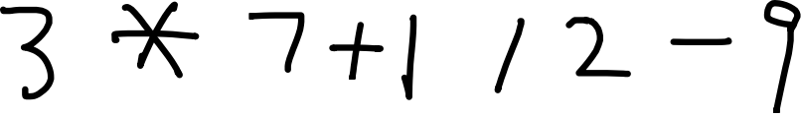
-
Pre-order
- / * 3 + 7 1 2 9
/
9
*
2
In-order
3 * 7 + 1 / 2 - 9
3
+
7
1
3 * (7 + 1) / 2 - 9

Slide 22







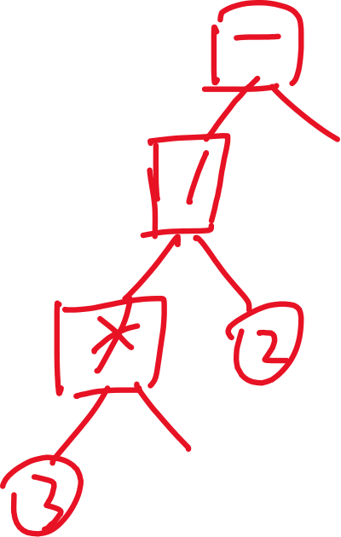

-
Pre-order
- / * 3 + 7 1 2 9
/
9
In-order
*
2
In-order
3 * 7 + 1 / 2 - 9
3
+
7
1
3 * (7 + 1) / 2 - 9

Slide 23



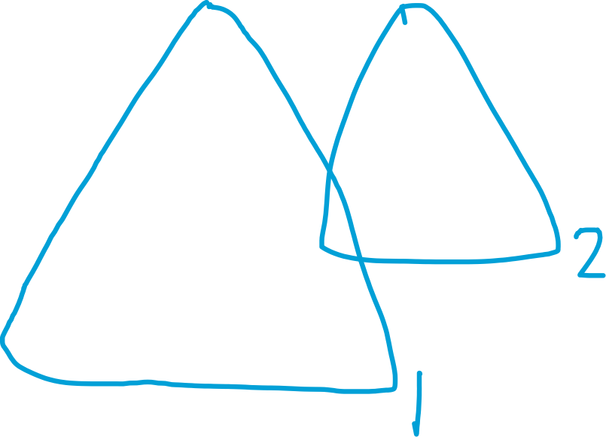

-
Pre-order
- / * 3 + 7 1 2 9
/
9
In-order
*
2
In-order
3 * 7 + 1 / 2 - 9
3
+
7
1
3 * (7 + 1) / 2 - 9

Slide 24



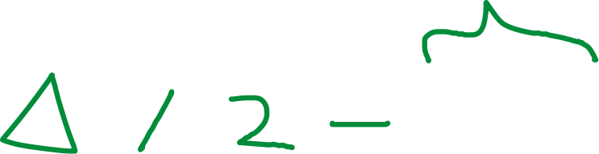
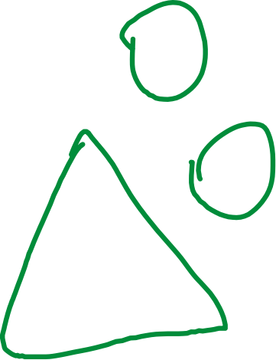
-
Pre-order
- / * 3 + 7 1 2 9
/
9
In-order
*
2
In-order
3 * 7 + 1 / 2 - 9
3
+
7
1
3 * (7 + 1) / 2 - 9

Slide 25








-
Pre-order
- / * 3 + 7 1 2 9
/
9
In-order
*
2
In-order
3 * 7 + 1 / 2 - 9
3
+
7
1
3 * (7 + 1) / 2 - 9

Slide 26
-
Pre-order
- / * 3 + 7 1 2 9
/
9
*
2
In-order
3 * 7 + 1 / 2 - 9
3
+
Post-order
3 7 1 + * 2 / 9 -
7
1
3 * (7 + 1) / 2 - 9

Slide 27
-
Pre-order
Prefix form
Polish Notation
- / * 3 + 7 1 2 9
/
9
In-order
Infix form
3 * 7 + 1 / 2 - 9
*
2
3
+
Post-order
Postfix form
Reverse Polish Notation
3 7 1 + * 2 / 9 -
7
1
3 * (7 + 1) / 2 - 9

Slide 28
-
/
9
In-order
Infix form
3 * 7 + 1 / 2 - 9
*
2
3
+
7
1
DIFFERENT!
3 * (7 + 1) / 2 - 9

Slide 29
Same infix form,
DIFFERENT shapes!
-
-
/
9
+
9
*
2
*
/
3
+
3
7
1
2
7
1
In-order
Infix form
3 * 7 + 1 / 2 - 9
3 * (7 + 1) / 2 - 9
Notes:
在任何地方加括号，中缀总是不变的

Slide 30
-
Pre-order
Prefix form
Polish Notation
- / * 3 + 7 1 2 9
/
9
*
2
3
+
Post-order
Postfix form
Reverse Polish Notation
3 7 1 + * 2 / 9 -
7
1
3 * (7 + 1) / 2 - 9

Slide 31
-
Pre-order
Prefix form
Polish Notation
- / * 3 + 7 1 2 9
/
9
*
2
3
+
7
1
3 * (7 + 1) / 2 - 9

Slide 32
-
Pre-order
Prefix form
Polish Notation
- / * 3 + 7 1 2 9
/
9
*
2
3
+
7
1
-
3 * (7 + 1) / 2 - 9

Slide 33
-
Pre-order
Prefix form
Polish Notation
- / * 3 + 7 1 2 9
/
9
*
2
3
+
7
1
/
-
3 * (7 + 1) / 2 - 9

Slide 34
-
Pre-order
Prefix form
Polish Notation
- / * 3 + 7 1 2 9
/
9
*
2
3
+
7
1
*
/
-
3 * (7 + 1) / 2 - 9

Slide 35
-
Pre-order
Prefix form
Polish Notation
- / * 3 + 7 1 2 9
/
9
*
2
3
+
3
7
1
*
/
-
3 * (7 + 1) / 2 - 9

Slide 36
-
Pre-order
Prefix form
Polish Notation
- / * 3 + 7 1 2 9
/
9
*
2
3
+
+
3
7
1
*
/
-
3 * (7 + 1) / 2 - 9

Slide 37
-
Pre-order
Prefix form
Polish Notation
- / * 3 + 7 1 2 9
/
9
*
2
7
3
+
+
3
7
1
*
/
-
3 * (7 + 1) / 2 - 9

Slide 38
-
Pre-order
Prefix form
Polish Notation
- / * 3 + 7 1 2 9
/
9
*
2
1
7
3
+
+
3
7
1
*
/
-
3 * (7 + 1) / 2 - 9

Slide 39
-
Pre-order
Prefix form
Polish Notation
- / * 3 + 7 1 2 9
/
9
*
2
1
7
7 + 1
3
+
+
3
7
1
*
/
-
3 * (7 + 1) / 2 - 9

Slide 40
-
Pre-order
Prefix form
Polish Notation
- / * 3 + 7 1 2 9
/
9
*
2
3
+
3
7
1
7
1
*
+
/
-
3 * (7 + 1) / 2 - 9

Slide 41
-
Pre-order
Prefix form
Polish Notation
- / * 3 + 7 1 2 9
/
9
*
2
3
+
3
8
7
1
*
/
-
3 * (7 + 1) / 2 - 9

Slide 42
-
Pre-order
Prefix form
Polish Notation
- / * 3 + 7 1 2 9
/
9
*
2
3
+
8
3
7
1
*
/
-
3 * (7 + 1) / 2 - 9

Slide 43
-
Pre-order
Prefix form
Polish Notation
- / * 3 + 7 1 2 9
/
9
*
2
3
+
8
3
3 * 8
7
1
*
/
-
3 * (7 + 1) / 2 - 9

Slide 44
-
Pre-order
Prefix form
Polish Notation
- / * 3 + 7 1 2 9
/
9
*
2
3
+
*
7
1
3
8
/
-
3 * (7 + 1) / 2 - 9

Slide 45
-
Pre-order
Prefix form
Polish Notation
- / * 3 + 7 1 2 9
/
9
*
2
3
+
7
1
24
/
-
3 * (7 + 1) / 2 - 9

Slide 46
-
Pre-order
Prefix form
Polish Notation
- / * 3 + 7 1 2 9
/
9
*
2
3
+
7
1
24
/
-
3 * (7 + 1) / 2 - 9

Slide 47
-
Pre-order
Prefix form
Polish Notation
- / * 3 + 7 1 2 9
/
9
*
2
3
+
2
7
1
24
/
-
3 * (7 + 1) / 2 - 9

Slide 48
-
Pre-order
Prefix form
Polish Notation
- / * 3 + 7 1 2 9
/
9
*
2
3
+
2
7
1
24
24 / 2
/
-
3 * (7 + 1) / 2 - 9

Slide 49
-
Pre-order
Prefix form
Polish Notation
- / * 3 + 7 1 2 9
/
9
*
2
3
+
/
7
1
24
2
-
3 * (7 + 1) / 2 - 9

Slide 50
-
Pre-order
Prefix form
Polish Notation
- / * 3 + 7 1 2 9
/
9
*
2
3
+
/
7
1
24
2
-
3 * (7 + 1) / 2 - 9

Slide 51
-
Pre-order
Prefix form
Polish Notation
- / * 3 + 7 1 2 9
/
9
*
2
3
+
7
1
12
-
3 * (7 + 1) / 2 - 9

Slide 52
-
Pre-order
Prefix form
Polish Notation
- / * 3 + 7 1 2 9
/
9
*
2
3
+
7
1
12
-
3 * (7 + 1) / 2 - 9

Slide 53
-
Pre-order
Prefix form
Polish Notation
- / * 3 + 7 1 2 9
/
9
*
2
3
+
7
1
9
12
-
3 * (7 + 1) / 2 - 9

Slide 54
-
Pre-order
Prefix form
Polish Notation
- / * 3 + 7 1 2 9
/
9
*
2
3
+
7
1
9
12
12-9
-
3 * (7 + 1) / 2 - 9

Slide 55
-
Pre-order
Prefix form
Polish Notation
- / * 3 + 7 1 2 9
/
9
*
2
3
+
7
1
-
12
9
3 * (7 + 1) / 2 - 9

Slide 56
-
Pre-order
Prefix form
Polish Notation
- / * 3 + 7 1 2 9
/
9
*
2
3
+
7
1
3
3 * (7 + 1) / 2 - 9

Slide 57
-
Pre-order
Prefix form
Polish Notation
- / * 3 + 7 1 2 9
/
9
*
2
3
+
7
1
3
3 * (7 + 1) / 2 - 9

Slide 58
-
Pre-order
Prefix form
Polish Notation
- / * 3 + 7 1 2 9
/
9
*
2
3
+
Post-order
Postfix form
Reverse Polish Notation
3 7 1 + * 2 / 9 -
7
1
3 * (7 + 1) / 2 - 9

Slide 59
-
Post-order
Postfix form
Reverse Polish Notation
3 7 1 + * 2 / 9 -
/
9
*
2
3
+
7
1
3 * (7 + 1) / 2 - 9

Slide 60
-
Post-order
Postfix form
Reverse Polish Notation
3 7 1 + * 2 / 9 -
/
9
*
2
3
+
7
1
3
3 * (7 + 1) / 2 - 9

Slide 61
-
Post-order
Postfix form
Reverse Polish Notation
3 7 1 + * 2 / 9 -
/
9
*
2
3
+
+
7
1
1
7
3
3 * (7 + 1) / 2 - 9

Slide 62
-
Post-order
Postfix form
Reverse Polish Notation
3 7 1 + * 2 / 9 -
/
9
*
2
3
+
+
7
1
1
7 + 1
7
3
3 * (7 + 1) / 2 - 9

Slide 63
-
Post-order
Postfix form
Reverse Polish Notation
3 7 1 + * 2 / 9 -
/
9
*
2
3
+
7
1
8
3
3 * (7 + 1) / 2 - 9

Slide 64
-
Post-order
Postfix form
Reverse Polish Notation
3 7 1 + * 2 / 9 -
/
9
*
2
3
+
7
1
*
8
3
3 * (7 + 1) / 2 - 9

Slide 65
-
Post-order
Postfix form
Reverse Polish Notation
3 7 1 + * 2 / 9 -
/
9
*
2
3
+
7
1
*
8
3 * 8
3
3 * (7 + 1) / 2 - 9

Slide 66
-
Post-order
Postfix form
Reverse Polish Notation
3 7 1 + * 2 / 9 -
/
9
*
2
3
+
7
1
24
3 * (7 + 1) / 2 - 9

Slide 67
-
Post-order
Postfix form
Reverse Polish Notation
3 7 1 + * 2 / 9 -
/
9
*
2
3
+
7
1
2
24
3 * (7 + 1) / 2 - 9

Slide 68
-
Post-order
Postfix form
Reverse Polish Notation
3 7 1 + * 2 / 9 -
/
9
*
2
3
+
7
1
/
2
24 / 2
24
3 * (7 + 1) / 2 - 9

Slide 69
-
Post-order
Postfix form
Reverse Polish Notation
3 7 1 + * 2 / 9 -
/
9
*
2
3
+
7
1
12
3 * (7 + 1) / 2 - 9

Slide 70
-
Post-order
Postfix form
Reverse Polish Notation
3 7 1 + * 2 / 9 -
/
9
*
2
3
+
7
1
9
12
3 * (7 + 1) / 2 - 9

Slide 71
-
Post-order
Postfix form
Reverse Polish Notation
3 7 1 + * 2 / 9 -
/
9
*
2
3
+
7
1
-
9
12 - 9
12
3 * (7 + 1) / 2 - 9

Slide 72
-
Post-order
Postfix form
Reverse Polish Notation
3 7 1 + * 2 / 9 -
/
9
*
2
3
+
7
1
3
3 * (7 + 1) / 2 - 9

Slide 74
Recursion
Tree structures
Class hierarchies and inheritance
E
E
E
T T T T
y = 3 * (x + 1)

Slide 75
Recursive Structure of Expressions
In most programming languages, an expression is a recursive structure that can contain subexpressions.
Every expression can have one of the following forms:
An integer constant
A variable name that holds an integer value
Two expressions joined by an operator
An expression enclosed in parentheses
The rules for forming an expression can be expressed in the form of a grammar, as follows:
E → constant
1024
E → identifier
temp
E → E op E
temp + 1024
E → ( E )
(temp + 1024)

Slide 76
A Two-Level Grammar
The problem of parsing an expression can be simplified by changing the grammar to one that has two levels:
An expression is either a term or two expressions joined by an operator.
A term is either a constant, an identifier, or an expression enclosed in parentheses.
This design is reflected in the following revised grammar.
E → T
E → E op E
T → constant
T → identifier
T → ( E )

Slide 77
The Expression Class Hierarchy
Because expressions have more than one form, a C++ class that represents expressions can be represented most easily by a class hierarchy in which each of the expression types is a separate subclass, as shown in the following diagram:
Expression
ConstantExp
IdentifierExp
CompoundExp

Slide 78
Parsing an Expression
Parsing: Convert the string representation to an internal form
odd
=
2
*
n
+
1
COMPOUND
=
COMPOUND
+
COMPOUND
*
IDENTIFIER
CONSTANT
IDENTIFIER
CONSTANT
odd
2
n
1

Slide 79
Ambiguity in Parse Structures
Although the two-level grammar from the preceding slide can recognize any expression, it is ambiguous because the same input string can generate more than one parse tree.
E
E
E
E
T
T
T
T
T
T
x
+
2
*
y
x
+
2
*
y
Ambiguity in grammars is typically resolved by providing the parser with information about the precedence of the operators.

Slide 80
Precedence
precedence | operators
3 | * /
2 | + -
1 | =

Slide 81
Parsing an expression
Several approaches
Recursive parsing
Infix parsing using stacks

Slide 82
Example: Parsing using stacks
Odd = 1 + n * (2 – x) / 2

Slide 83
odd
=
1
+
n
*
(
2
-
x
)
/
2
Odd = 1 + n * (2 – x) / 2

Slide 84
precedence | operators
3 | * /
2 | + -
1 | =
Operators
Operands
odd
=
1
+
n
*
(
2
-
x
)
/
2
Odd = 1 + n * (2 – x) / 2

Slide 85
precedence | operators
3 | * /
2 | + -
1 | =
IDENTIFIER
Operators
Operands
odd
=
1
+
n
*
(
2
-
x
)
/
2
Odd = 1 + n * (2 – x) / 2

Slide 86
precedence | operators
3 | * /
2 | + -
1 | =
1
=
precedence
IDENTIFIER
Operators
Operands
odd
1
+
n
*
(
2
-
x
)
/
2
Odd = 1 + n * (2 – x) / 2

Slide 87
precedence | operators
3 | * /
2 | + -
1 | =
1
=
precedence
IDENTIFIER
CONSTANT
Operators
Operands
odd
1
+
n
*
(
2
-
x
)
/
2
Odd = 1 + n * (2 – x) / 2

Slide 88
precedence | operators
3 | * /
2 | + -
1 | =
2
+
1
=
precedence
IDENTIFIER
CONSTANT
Operators
Operands
odd
1
n
*
(
2
-
x
)
/
2
Odd = 1 + n * (2 – x) / 2

Slide 89
precedence | operators
3 | * /
2 | + -
1 | =
2
+
1
=
precedence
IDENTIFIER
CONSTANT
IDENTIFIER
Operators
Operands
odd
1
n
*
(
2
-
x
)
/
2
Odd = 1 + n * (2 – x) / 2

Slide 90
precedence | operators
3 | * /
2 | + -
1 | =
3
*
2
+
1
=
precedence
IDENTIFIER
CONSTANT
IDENTIFIER
Operators
Operands
odd
1
n
(
2
-
x
)
/
2
Odd = 1 + n * (2 – x) / 2

Slide 91
precedence | operators
3 | * /
2 | + -
1 | =
(
3
*
2
+
1
=
precedence
IDENTIFIER
CONSTANT
IDENTIFIER
Operators
Operands
odd
1
n
2
-
x
)
/
2
Odd = 1 + n * (2 – x) / 2

Slide 92
precedence | operators
3 | * /
2 | + -
1 | =
(
3
*
2
+
1
=
precedence
IDENTIFIER
CONSTANT
IDENTIFIER
CONSTANT
Operators
Operands
odd
1
n
2
-
x
)
/
2
Odd = 1 + n * (2 – x) / 2

Slide 93
precedence | operators
3 | * /
2 | + -
1 | =
2
-
(
3
*
2
+
1
=
precedence
IDENTIFIER
CONSTANT
IDENTIFIER
CONSTANT
Operators
Operands
odd
1
n
2
x
)
/
2
Odd = 1 + n * (2 – x) / 2

Slide 94
precedence | operators
3 | * /
2 | + -
1 | =
2
-
IDENTIFIER
(
x
3
*
2
+
1
=
precedence
IDENTIFIER
CONSTANT
IDENTIFIER
CONSTANT
Operators
Operands
odd
1
n
2
)
/
2
Odd = 1 + n * (2 – x) / 2

Slide 95
precedence | operators
3 | * /
2 | + -
1 | =
Pop until (
)
2
-
IDENTIFIER
(
x
3
*
2
+
1
=
precedence
IDENTIFIER
CONSTANT
IDENTIFIER
CONSTANT
Operators
Operands
odd
1
n
2
/
2
Odd = 1 + n * (2 – x) / 2

Slide 96
precedence | operators
3 | * /
2 | + -
1 | =
COMPOUND
-
Pop until (
)
IDENTIFIER
(
x
3
*
2
+
1
=
precedence
IDENTIFIER
CONSTANT
IDENTIFIER
CONSTANT
Operators
Operands
odd
1
n
2
/
2
Odd = 1 + n * (2 – x) / 2

Slide 97
precedence | operators
3 | * /
2 | + -
1 | =
COMPOUND
-
Pop until (
)
IDENTIFIER
(
x
3
*
2
+
1
=
precedence
IDENTIFIER
CONSTANT
IDENTIFIER
CONSTANT
Operators
Operands
odd
1
n
2
/
2
Odd = 1 + n * (2 – x) / 2

Slide 98
precedence | operators
3 | * /
2 | + -
1 | =
COMPOUND
-
Pop until (
)
CONSTANT
IDENTIFIER
(
2
x
3
*
2
+
1
=
precedence
IDENTIFIER
CONSTANT
IDENTIFIER
Operators
Operands
odd
1
n
/
2
Odd = 1 + n * (2 – x) / 2

Slide 99
precedence | operators
3 | * /
2 | + -
1 | =
COMPOUND
-
Pop until (
)
CONSTANT
IDENTIFIER
(
2
x
3
*
2
+
1
=
precedence
IDENTIFIER
CONSTANT
IDENTIFIER
Operators
Operands
odd
1
n
/
2
Odd = 1 + n * (2 – x) / 2

Slide 100
precedence | operators
3 | * /
2 | + -
1 | =
COMPOUND
-
Pop until (
(
)
CONSTANT
IDENTIFIER
2
x
3
*
2
+
1
=
precedence
IDENTIFIER
CONSTANT
IDENTIFIER
Operators
Operands
odd
1
n
/
2
Odd = 1 + n * (2 – x) / 2

Slide 101
precedence | operators
3 | * /
2 | + -
1 | =
COMPOUND
-
CONSTANT
IDENTIFIER
2
x
3
*
2
+
1
=
precedence
IDENTIFIER
CONSTANT
IDENTIFIER
Operators
Operands
odd
1
n
/
2
Odd = 1 + n * (2 – x) / 2

Slide 102
precedence | operators
3 | * /
2 | + -
1 | =
COMPOUND
-
Pop until top’s precedence < 3
3
/
CONSTANT
IDENTIFIER
2
x
3
*
2
+
1
=
precedence
IDENTIFIER
CONSTANT
IDENTIFIER
Operators
Operands
odd
1
n
2
Odd = 1 + n * (2 – x) / 2

Slide 103
precedence | operators
3 | * /
2 | + -
1 | =
COMPOUND
COMPOUND
*
-
3
/
CONSTANT
IDENTIFIER
2
x
2
+
1
=
precedence
IDENTIFIER
CONSTANT
IDENTIFIER
Operators
Operands
odd
1
n
2
Odd = 1 + n * (2 – x) / 2

Slide 104
precedence | operators
3 | * /
2 | + -
1 | =
COMPOUND
COMPOUND
*
-
3
/
CONSTANT
IDENTIFIER
2
x
2
+
1
=
precedence
IDENTIFIER
CONSTANT
IDENTIFIER
Operators
Operands
odd
1
n
2
Odd = 1 + n * (2 – x) / 2

Slide 105
precedence | operators
3 | * /
2 | + -
1 | =
COMPOUND
COMPOUND
*
-
3
/
CONSTANT
IDENTIFIER
2
x
2
+
1
=
precedence
IDENTIFIER
CONSTANT
IDENTIFIER
Operators
Operands
odd
1
n
2
Odd = 1 + n * (2 – x) / 2

Slide 106
precedence | operators
3 | * /
2 | + -
1 | =
COMPOUND
COMPOUND
*
-
3
/
CONSTANT
IDENTIFIER
2
x
2
+
1
=
precedence
IDENTIFIER
CONSTANT
IDENTIFIER
Operators
Operands
odd
1
n
2
Odd = 1 + n * (2 – x) / 2

Slide 107
precedence | operators
3 | * /
2 | + -
1 | =
COMPOUND
*
3
/
COMPOUND
-
CONSTANT
IDENTIFIER
2
+
2
x
1
=
precedence
IDENTIFIER
CONSTANT
IDENTIFIER
Operators
Operands
odd
1
n
2
Odd = 1 + n * (2 – x) / 2

Slide 108
precedence | operators
3 | * /
2 | + -
1 | =
COMPOUND
*
COMPOUND
-
3
/
CONSTANT
IDENTIFIER
2
+
2
x
1
=
precedence
IDENTIFIER
CONSTANT
IDENTIFIER
Operators
Operands
odd
1
n
2
Odd = 1 + n * (2 – x) / 2

Slide 109
precedence | operators
3 | * /
2 | + -
1 | =
COMPOUND
*
COMPOUND
-
CONSTANT
2
3
/
CONSTANT
IDENTIFIER
2
+
2
x
1
=
precedence
IDENTIFIER
CONSTANT
IDENTIFIER
Operators
Operands
odd
1
n
Odd = 1 + n * (2 – x) / 2

Slide 110
precedence | operators
3 | * /
2 | + -
1 | =
COMPOUND
/
COMPOUND
*
COMPOUND
-
CONSTANT
2
CONSTANT
IDENTIFIER
2
+
2
x
1
=
precedence
IDENTIFIER
CONSTANT
IDENTIFIER
Operators
Operands
odd
1
n
Odd = 1 + n * (2 – x) / 2

Slide 111
precedence | operators
3 | * /
2 | + -
1 | =
COMPOUND
/
COMPOUND
*
COMPOUND
-
CONSTANT
2
CONSTANT
IDENTIFIER
2
+
2
x
1
=
precedence
IDENTIFIER
CONSTANT
IDENTIFIER
Operators
Operands
odd
1
n
Odd = 1 + n * (2 – x) / 2

Slide 112
precedence | operators
3 | * /
2 | + -
1 | =
COMPOUND
/
COMPOUND
*
COMPOUND
-
CONSTANT
2
CONSTANT
IDENTIFIER
2
+
2
x
1
=
precedence
IDENTIFIER
CONSTANT
IDENTIFIER
Operators
Operands
odd
1
n
Odd = 1 + n * (2 – x) / 2

Slide 113
precedence | operators
3 | * /
2 | + -
1 | =
COMPOUND
/
COMPOUND
*
COMPOUND
-
CONSTANT
2
CONSTANT
IDENTIFIER
2
+
2
x
1
=
precedence
IDENTIFIER
CONSTANT
IDENTIFIER
Operators
Operands
odd
1
n
Odd = 1 + n * (2 – x) / 2

Slide 114
precedence | operators
3 | * /
2 | + -
1 | =
COMPOUND
/
COMPOUND
CONSTANT
*
2
COMPOUND
-
CONSTANT
IDENTIFIER
2
+
2
x
1
=
precedence
IDENTIFIER
CONSTANT
IDENTIFIER
Operators
Operands
odd
1
n
Odd = 1 + n * (2 – x) / 2

Slide 115
precedence | operators
3 | * /
2 | + -
1 | =
COMPOUND
COMPOUND
+
/
COMPOUND
CONSTANT
*
2
COMPOUND
-
CONSTANT
IDENTIFIER
2
x
1
=
precedence
IDENTIFIER
CONSTANT
IDENTIFIER
Operators
Operands
odd
1
n
Odd = 1 + n * (2 – x) / 2

Slide 116
precedence | operators
3 | * /
2 | + -
1 | =
COMPOUND
COMPOUND
+
/
COMPOUND
CONSTANT
*
2
COMPOUND
-
CONSTANT
IDENTIFIER
2
x
1
=
precedence
IDENTIFIER
CONSTANT
IDENTIFIER
Operators
Operands
odd
1
n
Odd = 1 + n * (2 – x) / 2

Slide 117
precedence | operators
3 | * /
2 | + -
1 | =
COMPOUND
COMPOUND
+
/
COMPOUND
CONSTANT
*
2
COMPOUND
-
CONSTANT
IDENTIFIER
2
x
1
=
precedence
IDENTIFIER
CONSTANT
IDENTIFIER
Operators
Operands
odd
1
n
Odd = 1 + n * (2 – x) / 2

Slide 118
precedence | operators
3 | * /
2 | + -
1 | =
COMPOUND
COMPOUND
+
/
COMPOUND
CONSTANT
*
2
COMPOUND
-
CONSTANT
IDENTIFIER
2
x
1
=
precedence
IDENTIFIER
CONSTANT
IDENTIFIER
Operators
Operands
odd
1
n
Odd = 1 + n * (2 – x) / 2

Slide 119
precedence | operators
3 | * /
2 | + -
1 | =
COMPOUND
COMPOUND
COMPOUND
=
+
/
COMPOUND
CONSTANT
*
2
COMPOUND
-
CONSTANT
IDENTIFIER
2
x
precedence
IDENTIFIER
CONSTANT
IDENTIFIER
Operators
Operands
odd
1
n
Odd = 1 + n * (2 – x) / 2

Slide 120
precedence | operators
3 | * /
2 | + -
1 | =
COMPOUND
COMPOUND
COMPOUND
=
+
/
COMPOUND
CONSTANT
*
2
COMPOUND
-
CONSTANT
IDENTIFIER
2
x
precedence
IDENTIFIER
CONSTANT
IDENTIFIER
Operators
Operands
odd
1
n
Odd = 1 + n * (2 – x) / 2

Slide 121
precedence | operators
3 | * /
2 | + -
1 | =
COMPOUND
COMPOUND
COMPOUND
=
+
/
COMPOUND
CONSTANT
*
2
COMPOUND
-
CONSTANT
IDENTIFIER
2
x
precedence
IDENTIFIER
CONSTANT
IDENTIFIER
Operators
Operands
odd
1
n
Odd = 1 + n * (2 – x) / 2

Slide 122
precedence | operators
3 | * /
2 | + -
1 | =
COMPOUND
COMPOUND
COMPOUND
=
+
/
COMPOUND
CONSTANT
*
2
COMPOUND
-
CONSTANT
IDENTIFIER
2
x
precedence
IDENTIFIER
CONSTANT
IDENTIFIER
Operators
Operands
odd
1
n
Odd = 1 + n * (2 – x) / 2

Slide 123
COMPOUND
COMPOUND
COMPOUND
=
+
/
COMPOUND
CONSTANT
*
2
COMPOUND
-
CONSTANT
IDENTIFIER
2
x
IDENTIFIER
CONSTANT
IDENTIFIER
odd
1
n
Odd = 1 + n * (2 – x) / 2

Slide 124
COMPOUND
=
COMPOUND
IDENTIFIER
+
odd
COMPOUND
CONSTANT
/
1
COMPOUND
CONSTANT
*
2
COMPOUND
IDENTIFIER
-
n
CONSTANT
IDENTIFIER
2
x
Odd = 1 + n * (2 – x) / 2

Slide 125
Recommended Files
main.cpp | Main file of the project
mainwindow.h/cpp/ui | Main Window (and UI)
program.h/cpp | Declare/implement a stored program
statement.h/cpp | Declare/implement statements
exp.h/cpp | Declare/implement expressions
parser.h/cpp | Parse a given expression
tokenizer.h/cpp | Convert satrings to a list of tokens
evalstate.h/cpp | A space storing all variables during evaluation

Slide 126
The exp.h Interface
/*
* File: exp.h
* -----------
* This interface defines a class hierarchy for arithmetic expressions.
*/
#ifndef _exp_h
#define _exp_h
#include <string>
#include "map.h"
#include "tokenscanner.h"
/* Forward reference */
class EvaluationContext;
/*
* Type: ExpressionType
* --------------------
* This enumerated type is used to differentiate the three different
* expression types: CONSTANT, IDENTIFIER, and COMPOUND.
*/
enum ExpressionType { CONSTANT, IDENTIFIER, COMPOUND };

Slide 127
The exp.h Interface
/*
* File: exp.h
* -----------
* This interface defines a class hierarchy for arithmetic expressions.
*/
#ifndef _exp_h
#define _exp_h
#include <string>
#include "map.h"
#include "tokenscanner.h"
/* Forward reference */
class EvaluationContext;
/*
* Type: ExpressionType
* --------------------
* This enumerated type is used to differentiate the three different
* expression types: CONSTANT, IDENTIFIER, and COMPOUND.
*/
enum ExpressionType { CONSTANT, IDENTIFIER, COMPOUND };
/*
* Class: Expression
* -----------------
* This class is used to represent a node in an expression tree.
* Expression itself is an abstract class. Every Expression object
* is therefore created using one of the three concrete subclasses:
* ConstantExp, IdentifierExp, or CompoundExp.
*/
class Expression {
public:
Expression();
virtual ~Expression();
virtual int eval(EvaluationContext & context) = 0;
virtual std::string toString() = 0;
virtual ExpressionType type() = 0;
/* Getter methods for convenience */
virtual int getConstantValue();
virtual std::string getIdentifierName();
virtual std::string getOperator();
virtual Expression *getLHS();
virtual Expression *getRHS();
};

Slide 128
The exp.h Interface
/*
* Class: ConstantExp
* ------------------
* This subclass represents a constant integer expression.
*/
class ConstantExp: public Expression {
public:
ConstantExp(int val);
virtual int eval(EvaluationContext & context);
virtual std::string toString();
virtual ExpressionType type();
virtual int getConstantValue();
private:
int value;
};
/*
* Class: Expression
* -----------------
* This class is used to represent a node in an expression tree.
* Expression itself is an abstract class. Every Expression object
* is therefore created using one of the three concrete subclasses:
* ConstantExp, IdentifierExp, or CompoundExp.
*/
class Expression {
public:
Expression();
virtual ~Expression();
virtual int eval(EvaluationContext & context) = 0;
virtual std::string toString() = 0;
virtual ExpressionType type() = 0;
/* Getter methods for convenience */
virtual int getConstantValue();
virtual std::string getIdentifierName();
virtual std::string getOperator();
virtual Expression *getLHS();
virtual Expression *getRHS();
};

Slide 129
The exp.h Interface
/*
* Class: IdentifierExp
* --------------------
* This subclass represents a expression corresponding to a variable.
*/
class IdentifierExp: public Expression {
public:
IdentifierExp(string name);
virtual int eval(EvaluationContext & context);
virtual std::string toString();
virtual ExpressionType type();
virtual string getIdentifierName();
private:
std::string name;
};
/*
* Class: ConstantExp
* ------------------
* This subclass represents a constant integer expression.
*/
class ConstantExp: public Expression {
public:
ConstantExp(int val);
virtual int eval(EvaluationContext & context);
virtual std::string toString();
virtual ExpressionType type();
virtual int getConstantValue();
private:
int value;
};

Slide 130
The exp.h Interface
/*
* Class: CompoundExp
* ------------------
* This subclass represents a compound expression.
*/
class CompoundExp: public Expression {
public:
CompoundExp(string op, Expression *lhs, Expression *rhs);
virtual ~CompoundExp();
virtual int eval(EvaluationContext & context);
virtual std::string toString();
virtual ExpressionType type();
virtual std::string getOperator();
virtual Expression *getLHS();
virtual Expression *getRHS();
private:
std::string op;
Expression *lhs, *rhs;
};
/*
* Class: IdentifierExp
* --------------------
* This subclass represents a expression corresponding to a variable.
*/
class IdentifierExp: public Expression {
public:
IdentifierExp(string name);
virtual int eval(EvaluationContext & context);
virtual std::string toString();
virtual ExpressionType type();
virtual string getIdentifierName();
private:
std::string name;
};

Slide 131
The exp.h Interface
/*
* Class: EvaluationContext
* ------------------------
* This class encapsulates the information that the evaluator needs to
* know in order to evaluate an expression.
*/
class EvaluationContext {
public:
void setValue(std::string var, int value);
int getValue(std::string var);
bool isDefined(std::string var);
private:
Map<std::string,int> symbolTable;
};
#endif
/*
* Class: CompoundExp
* ------------------
* This subclass represents a compound expression.
*/
class CompoundExp: public Expression {
public:
CompoundExp(string op, Expression *lhs, Expression *rhs);
virtual ~CompoundExp();
virtual int eval(EvaluationContext & context);
virtual std::string toString();
virtual ExpressionType type();
virtual std::string getOperator();
virtual Expression *getLHS();
virtual Expression *getRHS();
private:
std::string op;
Expression *lhs, *rhs;
};

Slide 132
Selecting Fields from Subtypes
The Expression class exports several methods that allow clients to select fields from one of the concrete subtypes:
virtual int getConstantValue();
virtual std::string getIdentifierName();
virtual std::string getOperator();
virtual Expression *getLHS();
virtual Expression *getRHS();
The implementation of these methods in the Expression class always generates an error. Each subclass overrides that implementation with code that returns the appropriate instance variable.
These methods exist primarily for the convenience of the client. A more conventional strategy would be to have each subclass export only the getters that apply to that subtype. Adopting this strategy, however, forces clients to include explicit type casting, which quickly gets rather tedious.

Slide 133
Code for the eval Method
int ConstantExp::eval(EvaluationContext & context) {
return value;
}
int IdentifierExp::eval(EvaluationContext & context) {
if (!context.isDefined(name)) error(name + " is undefined");
return context.getValue(name);
}
int CompoundExp::eval(EvaluationContext & context) {
int right = rhs->eval(context);
if (op == "=") {
context.setValue(lhs->getIdentifierName(), right);
return right;
}
int left = lhs->eval(context);
if (op == "+") return left + right;
if (op == "-") return left - right;
if (op == "*") return left * right;
if (op == "/") {
if (right == 0) error("Division by 0");
return left / right;
}
error("Illegal operator in expression");
return 0;
}

Slide 134
Exercise: Evaluating an Expression
Trace through the steps involved in evaluating the expression
y = ( 9 – x ) * 7
in a context in which x has the value 3. The representation of this expression looks like this:
COMP
=
ID
COMP
y
*
COMP
CONST
-
7
CONST
ID
9
x

Slide 135
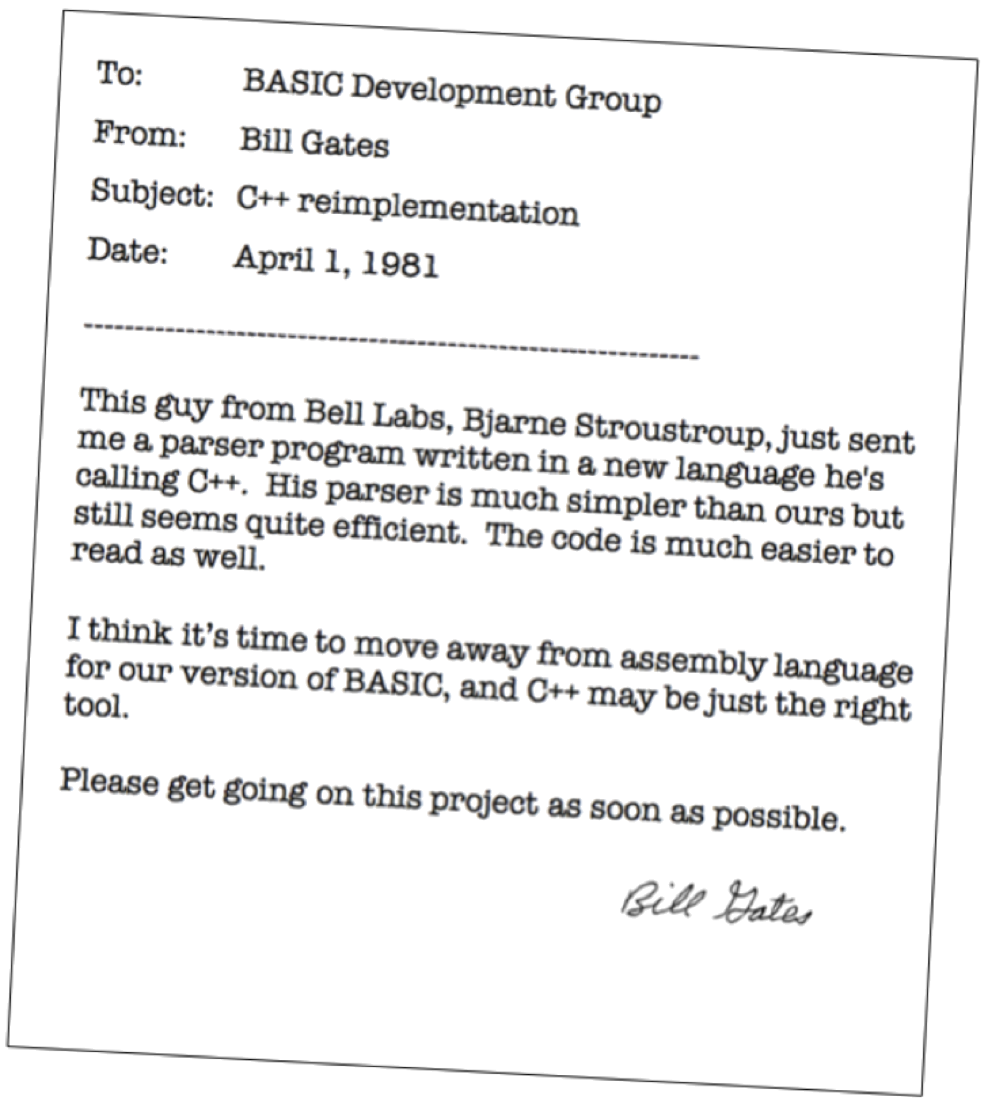

Slide 136
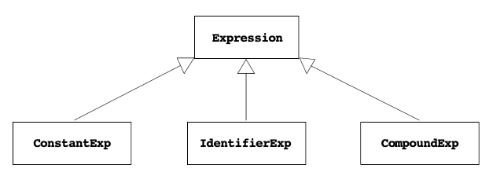
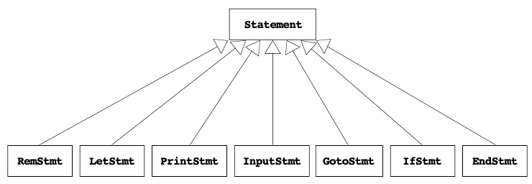
The Expression/Statement Class Hierarchy

Slide 138
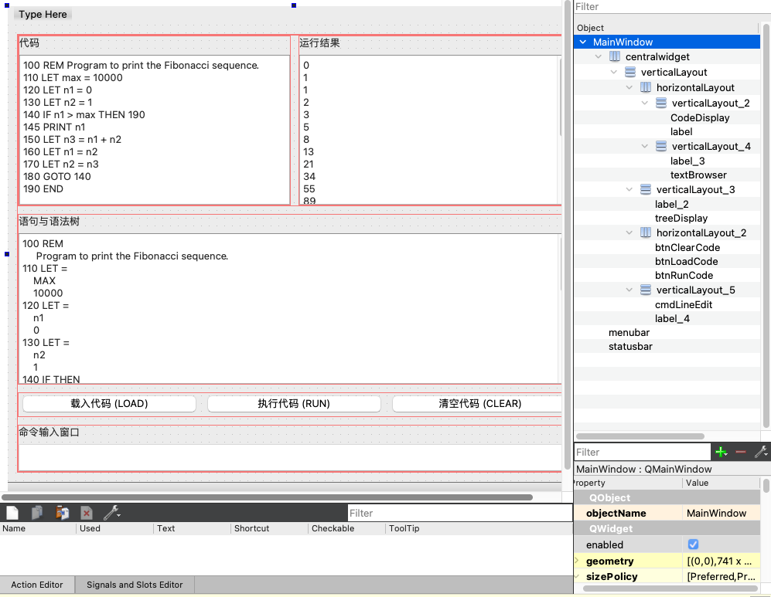
Recommended UI Layout

Slide 139
多阶段实现
画 GUI 界面，实现交互（如获取用户输入）
实现程序保存、加载、编辑、显示等
实现 Let、Print 等语句
实现 Expression 的 parsing 和 evaluate（此时应该有完整的程序结构，链表+语法树）
项目的其他部分（最终提交）

